Slide 1

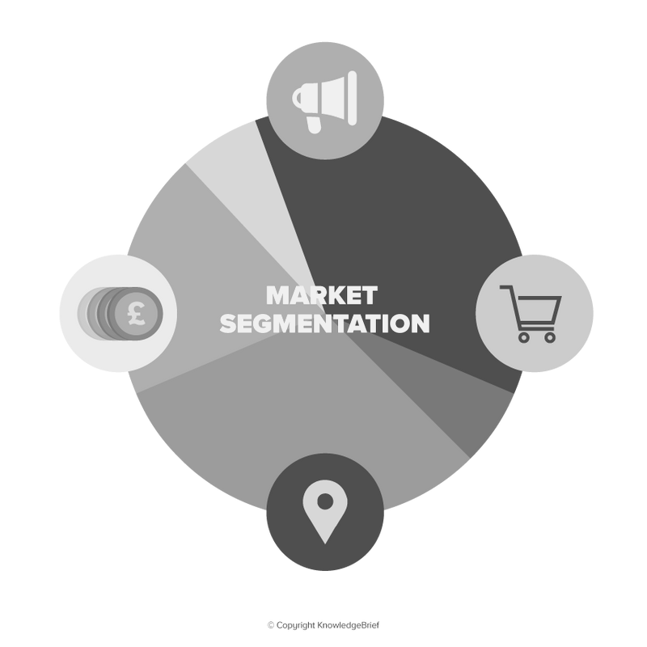


GROUP NO. 10
SEGMENTATION
Aarti Anil Zikre
Andrews Truman Premkumar Janakbhai Patel
Vitthlesh Sheth

Slide 2


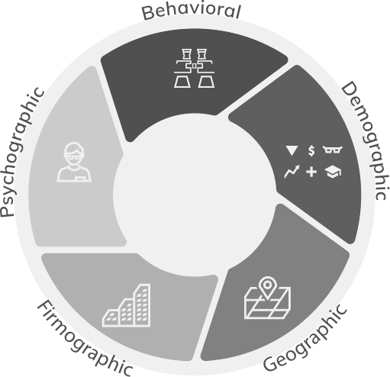

02
ABOUT OUR PROJECT
Welcome to our marketing analytics project in DAB303. This project is designed to provide a deep understanding of a retail dataset, enabling us to perform various tasks related to exploratory data analysis, data visualization, and data modeling. Under the guidance of Professor Dr. Andreas S. Maniatis, we aim to gain valuable insights that can inform marketing strategies.

Slide 3



03
DATA
MISSION
Transnational data set: UK online retail, 01/12/2010 - 09/12/2011, specializes in unique gifts, many wholesale customers.
Conduct EDA for dataset insights, use advanced ML like segmentation to find customer segments, and extract audience insights for improved marketing strategies.

Slide 4


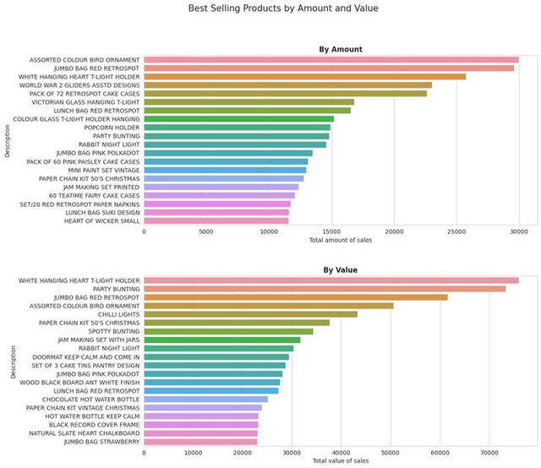
EXPLORATORY 04 DATA ANALYSIS
Best Selling Products by Amount and Value
we present a bar chart displaying the top 20 products that customers have purchased in the highest quantities. This visualization reveals the products with the greatest sales volume, giving us a clear understanding of which items are most popular among our customers.

Slide 5
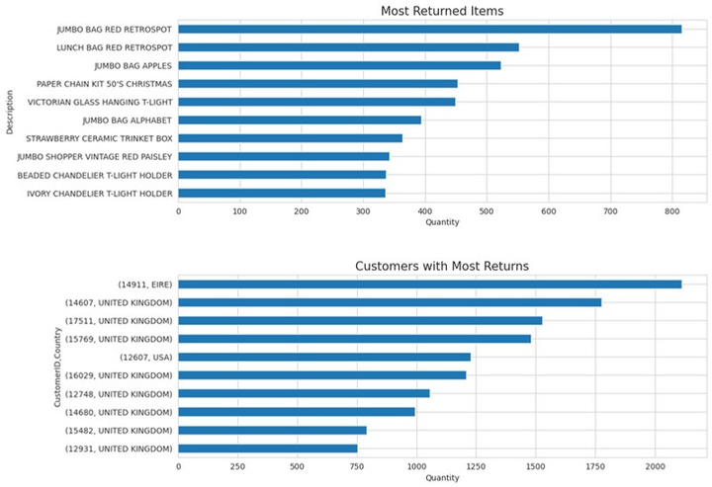
EXPLORATORY 05 DATA ANALYSIS
Finding the most returned items and the customers with the corresponding country
we present a chart highlighting the products that are returned most frequently by our customers. This visualization provides crucial insights into which items may have issues or are less satisfactory to our customer base. Understanding the reasons for returns is pivotal in improving product quality and customer satisfaction.

Slide 6
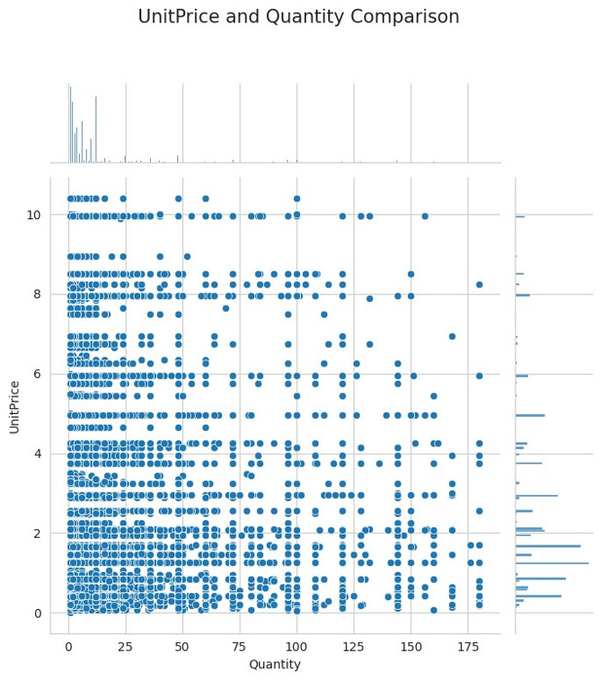
EXPLORATORY 06 DATA ANALYSIS
UnitPrice and Quantity Comparison
A jointplot depicts the connection between 'UnitPrice' and 'Quantity' of products purchased. It confirms that as prices rise, quantity sold decreases, and vice versa. This illustrates the crucial link between pricing and sales volume, guiding pricing and product strategies.

Slide 7
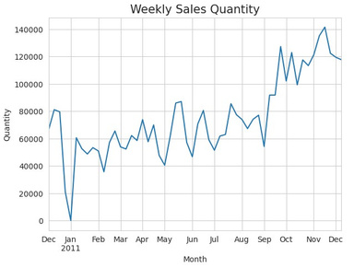
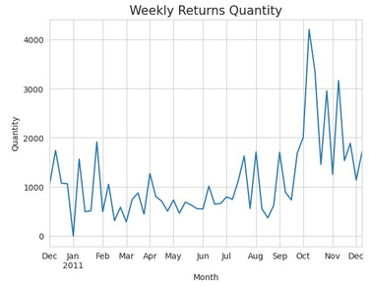
EXPLORATORY 07 DATA ANALYSIS
Weekly Sales and Returns
The weekly returns made by customers over the year. Returns appear relatively stable throughout the year, with minor fluctuations, except for a spike in the second week of October. This insight into return patterns helps us address customer satisfaction and product quality concerns more effectively.

Slide 8
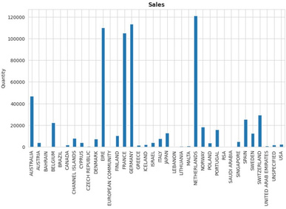
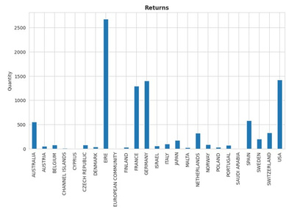
EXPLORATORY 08 DATA ANALYSIS
Sales in Foreign Countries
By focusing on countries other than the United Kingdom, we gain a clearer understanding of our international sales and return patterns, allowing us to make informed decisions to optimize our operations.

Slide 9
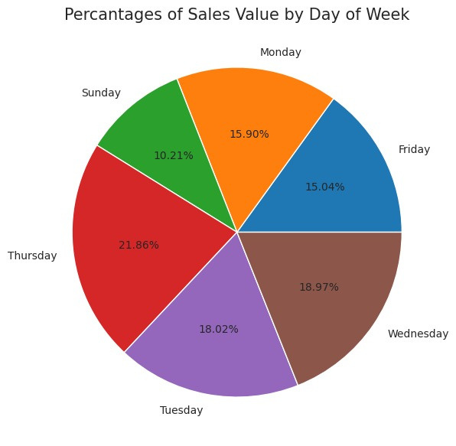
EXPLORATORY 09 DATA ANALYSIS
Percantages of Sales Value by Day of Week
The data reveals a notable pattern: Thursday consistently shows the highest sales value, while Sunday records the lowest sales value. This information sheds light on the variations in sales across different days of the week, which can be invaluable for optimizing sales and marketing strategies.

Slide 10
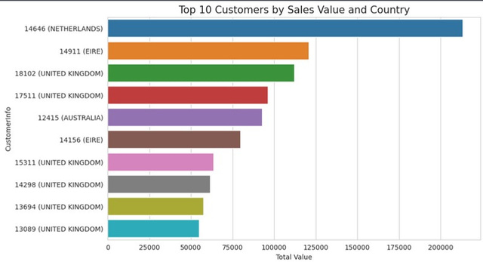
EXPLORATORY 10 DATA ANALYSIS
Top 10 Customers by Sales Value and Country
We present a chart that illustrates the sales value by each day of the week. The data reveals a notable pattern: Thursday consistently shows the highest sales value, while Sunday records the lowest sales value. This information sheds light on the variations in sales across different days of the week, which can be invaluable for optimizing sales and marketing strategies.
Understanding the sales patterns throughout the week allows us to align our marketing efforts and promotions with the days that exhibit the highest potential for sales, ultimately enhancing our business performance.

Slide 11
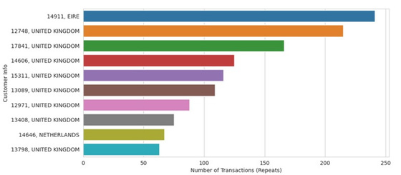
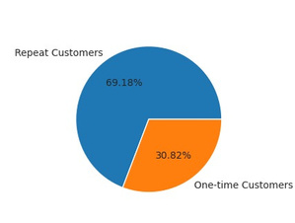
EXPLORATORY 11 DATA ANALYSIS
Top Repeat Customers
We present a chart that highlights our top customers based on the value they've contributed to the company. Additionally, we visualize the countries from which these valuable customers originate. This analysis allows us to appreciate and nurture our most significant customer relationships while gaining insights into the geographic distribution of these valued clients.

Slide 12
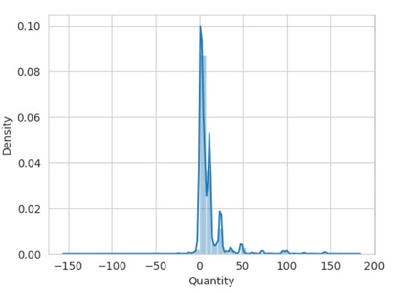
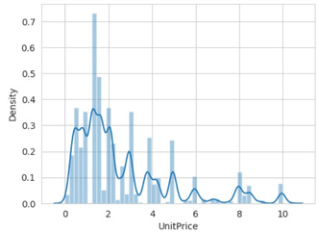
EXPLORATORY 12 DATA ANALYSIS
UnitPrice and Quantity Distribution
It represents the distribution of the 'UnitPrice' attribute. This plot provides insights into the distribution of unit prices for our products. Understanding the distribution of unit prices is crucial for pricing strategies and product positioning.

Slide 13
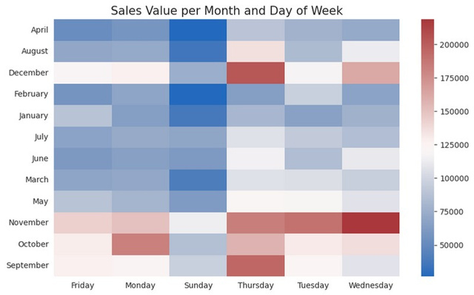
EXPLORATORY 13 DATA ANALYSIS
Sales Value per Month and Day of Week
We present a heatmap chart that illustrates how sales are distributed among different months and days of the week. The color scale represents the total value of sales, helping us identify the patterns in sales activity over the course of the year.

Slide 14




ASSOCIATION RULE MINING
14
Rule 1
Customers who buy a green alarm clock are highly likely to purchase a red alarm clock, with a confidence of 67.1% and a lift of 13.834.
Rule 2
There is a strong association between the "Roses Regency Teacup and Saucer" and the "Green Regency Teacup and Saucer." Customers who purchase one are very likely to buy the other, with a confidence of 69.1% and a lift of 18.017.
Rule 3
Customers often purchase both "Jumbo Bag Pink Polka Dot" and "Jumbo Bag Red RetroSpot," with a confidence of 61.5% and a lift of 7.162.
Rule 4
Different lunch bag designs, like "Lunch Bag Red RetroSpot" and "Lunch Bag Suki Design," show a connection, as customers who choose one design are likely to choose another, with a confidence of 40.1% and a lift of 6.926.

Slide 15




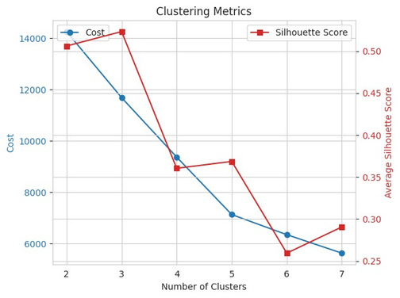



CUSTOMER 15 SEGMENTATION
USING CLUSTERING
Customer Segmentation
Customers are categorized into "UK" and "non-UK" groups to consider location-based behavior differences.
Data Aggregation
Individual customer data is consolidated, and statistics like average quantity, price, repeat purchases, and product variety are calculated.
Scaling Features
Numerical features are scaled to ensure balanced influence in clustering analysis.
Clustering Algorithm
In this particular case, the silhouette score is highest when using 3 clusters, which suggests that segmenting customers into three distinct groups may be the most suitable choice for this dataset.

Slide 16



THANK YOU
Group 10
DAB - 303 Marketing Analytics

